Slide 1


DEPARTMENT OF BCA
SUBJECT: COMPUTER NETWORKS SEMESTER: 3rd SEM BCA

Slide 2
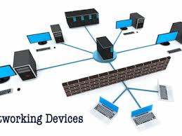
Network Devices
Networking devices, are electronic devices which are required for communication and interaction between devices on a computer network.

Slide 3
NIC (Network Interface Card)
It is also known as also Network Interface Unit (NIU).
A network interface card (NIC) is a hardware component, typically a circuit board or chip, which is installed on a computer so that it can connect to a network.
Functions of NIC:
NIC allows both wired and wireless communications.
NIC allows communications between computers connected via local area network (LAN) as well as communications over large-scale network through Internet Protocol (IP).
NIC is both a physical layer and a data link layer device, i.e. it provides the necessary hardware circuitry so that the physical layer processes and some data link layer processes can run on it.

Slide 4
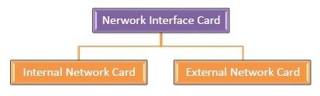
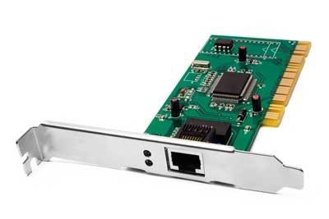
Internal Network Card :Motherboard has a slot for the network
card where it can be inserted. It requires network cables to provide network access

Slide 5
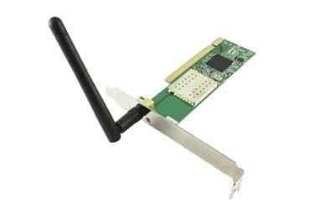
NIC contd.
External Network Card : desktops and laptops that do not have an internal NIC External network cards are of two types: Wireless and USB based.

Slide 6
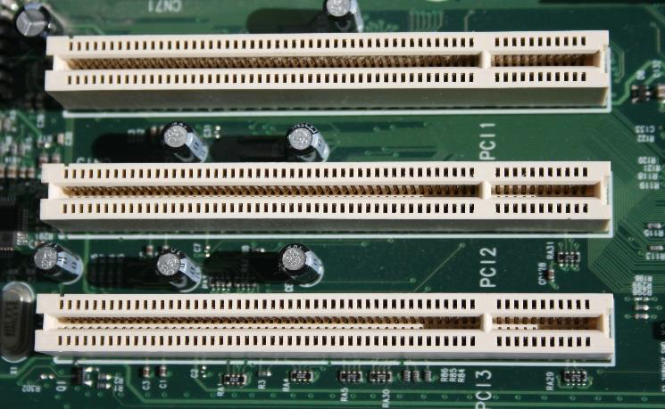
Steps of NIC installation
First step is to read the user's guide and familiarize yourself with the new card.
Power down PC and remove the AC power cord.
Open the computer case.
Find an available Peripheral Component Interconnect (PCI) slot on the motherboard and remove slot insert if one exists.

Slide 7
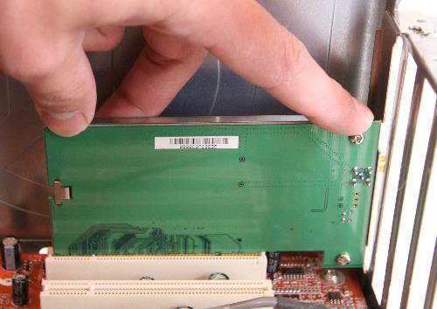
NIC installation Steps contd.
Carefully remove the network card from its static-proof plastic envelope, and slide it into the slot.
Seat the card in the slot firmly with gentle pressure along the length of the card, especially right about the slot itself.

Slide 8
NIC installation Steps contd.
Snugly, screw the card to the computer frame, but do not over tighten.
Close the computer case.
Plug your computer in and power it up.
Under the Network adapter, Double click the name of your Ethernet adapter. If the text in the "Device Status" box says "This device is working properly.", then you successfully installed the card and other wise trouble shoot again.

Slide 9
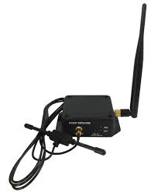
Repeater
A repeater operates at the physical layer.
Its job is to regenerate the signal over the same network before the signal becomes too weak or corrupted so as to extend the length to which the signal can be transmitted over the same network.

Slide 10
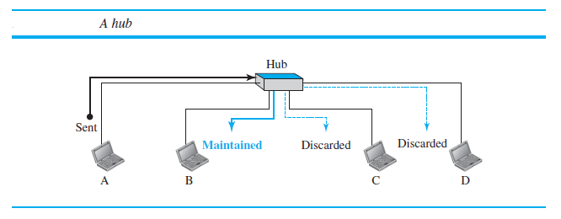
Hub
A hub is a device that operates only in the physical layer.
Signals that carry information within a network can travel a fixed distance before attenuation endangers the integrity of the data.

Slide 11
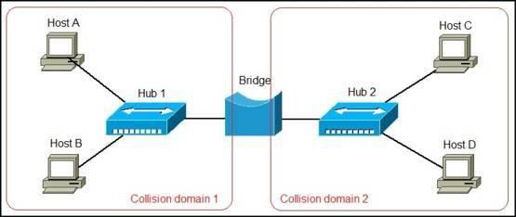
Bridge
A bridge operates at data link layer.
A bridge is a repeater, with add on the functionality of filtering content by reading the MAC addresses of source and destination.
It is also used for interconnecting two LANs working on the same protocol.

Slide 12
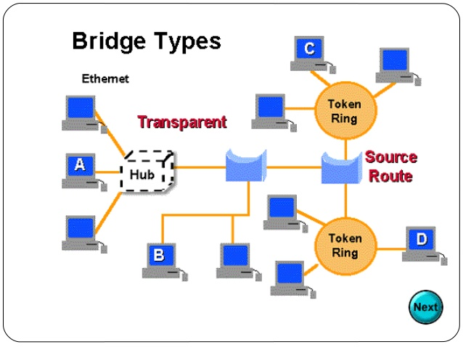
Bridge contd.

Slide 13
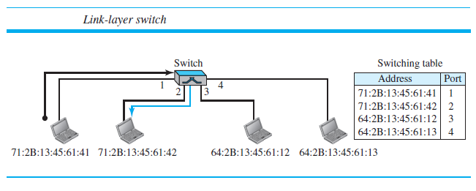
Switch
A switch is a data link layer device.
The switch can perform error checking before forwarding data that makes it very efficient as it does not forward packets that have errors and forward good packets selectively to correct port only.

Slide 14
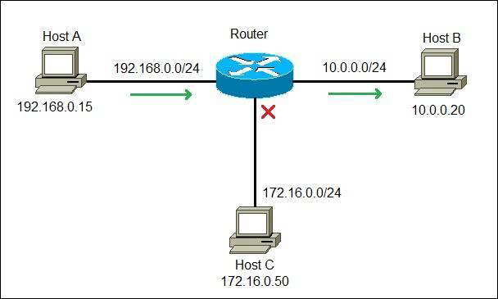
Routers
A router is a device like a switch that routes data packets based on their IP addresses.
Router is mainly a Network Layer device.

Slide 15
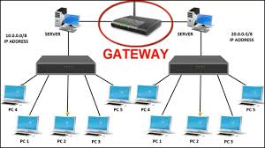
Gateways
gateway, as the name suggests, is a passage to connect two networks together that may work upon different networking models.
They basically work as the messenger agents that take data from one system, interpret it, and transfer it to another system.
Gateways are also called protocol converters and can operate at any network layer. Gateways are generally more complex than switch or router.

Slide 16
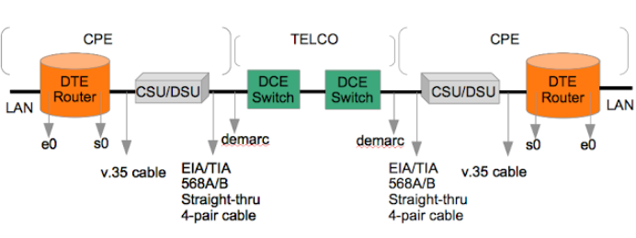
CSU/DSU
A Channel Service Unit/Digital Service Unit (CSU/DSU), sometimes called Data Service Unit, is a device that converts the digital signal format used on LANs into one used on WANs.
Such translation is necessary because the networking technologies used on WANs are different from those used on LANs.
The CSU/DSU sits between the LAN and the access point provided by the telecommunications company.
The channel service unit (CSU) is responsible for the connection to the telecommunication network, while the data service unit (DSU) is responsible for managing the interface with the data terminal equipment (DTE).

Slide 17
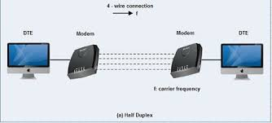
MODEM
A modem, short for modulator/demodulator, is a device that converts the digital signals generated by a computer into analog signals that can travel over conventional phone lines.
The modem at the receiving end converts the signal back into a format the computer can understand.

Slide 18
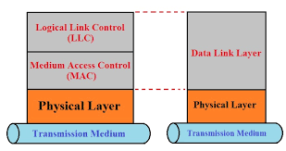
Data Link Layer
The data-link layer is located between the physical and the network layers.
The data link layer provides services to the network layer.
It receives services from the physical layer.
The data link layer provides error-free transmission of data frames from one node to another over the physical layer

Slide 19
Data link layer contd.
The LLC is common to all LANs and handles functions such as connection setup, initialization, data formatting, address recognition, error control, flow control and connection termination.
The MAC layer handles access to the shared medium and is specific to the type of LAN that is implemented

Slide 20
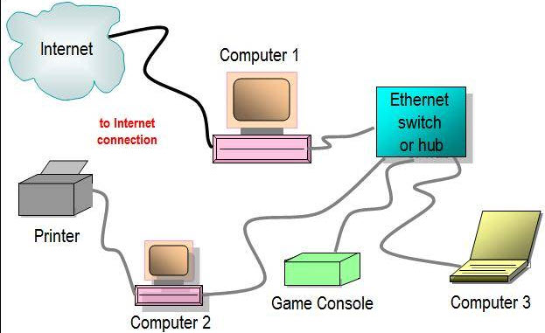
Ethernet
A family of computer networking technologies commonly used in local area networks (LAN), metropolitan area networks (MAN) and wide area networks (WAN).
Ethernet has largely replaced competing wired LAN technologies such as Token Ring, FDDI and ARCNET.

Slide 21
Ethernet standards
The IEEE 802 has subdivided the data-link layer into two sublayers as below:
Logical Link Control (LLC)
In IEEE Project 802, flow control, error control, and part of the framing duties are collected into one sublayer called the logical link control (LLC).
Framing is handled in both the LLC sublayer and the MAC sublayer.
Media Access Control (MAC)
IEEE Project 802 has created a sublayer called media access control that defines the specific access method for each LAN.
For example, it defines CSMA/CD as the media access method for Ethernet LANs and defines the token-passing method for Token Ring and Token Bus LANs.

Slide 22
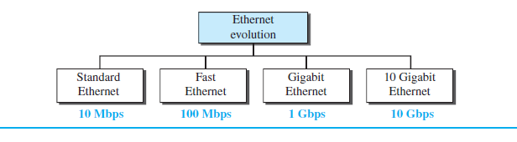
Ethernet Components
We refer to the original Ethernet technology with the data rate of 10 Mbps as the Standard Ethernet.

Slide 23
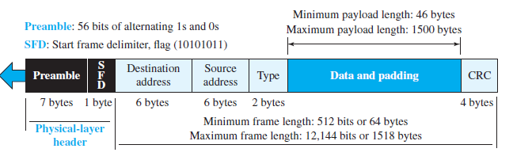
Ethernet Frame Format

Slide 24
Point-to-Point Protocol (PPP)
Point-to-Point Protocol (PPP) is a data link layer communications protocol between two routers directly without any host or any other networking in between.
It can provide connection authentication, transmission encryption, and compression.
Internet service providers (ISPs) have used PPP for customer dial-up access to the Internet.
PPP is used over many types of physical networks including serial cable, phone line, trunk line, cellular telephone, specialized radio links, and fiber optic links such as SONET.
Two derivatives of PPP, Point-to-Point Protocol over Ethernet (PPPoE) and Point-to-Point Protocol over ATM (PPPoA), are used most commonly by ISPs

Slide 25
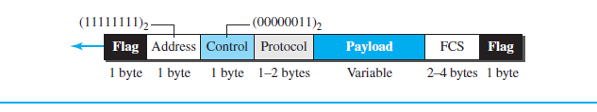
PPP Frame format

Slide 26
PPP functionalities
Encapsulation
2. Link Control Protocol
3. Network Control Protocols

Slide 27
Address Resolution Protocol
It is a communication protocol used for discovering the link layer address, such as a MAC address, associated with a given internet layer address, typically an IPv4 address.
ARP format

Slide 28
Packet Format of ARP fields
The names of the fields are self-explanatory.
The hardware type field defines the type of the link-layer protocol; Ethernet is given the type 1.
The protocol type field defines the network-layer protocol: IPv4 protocol is (0800)16.
The source hardware and source protocol addresses are variable-length fields defining the link-layer and network-layer addresses of the sender.
The destination hardware address and destination protocol address fields define the receiver link-layer and network-layer addresses.

Slide 29
Wireless Technology
Wireless communication is one of the fastest-growing technologies.
Wireless technology has helped to simplify networking by enabling multiple computer users to simultaneously share resources in a home or business without additional or intrusive wiring.
Wireless LANs can be found on college campuses, in office buildings, and in many public areas.

Slide 30
Benefits of Wireless Technology:
Wireless networking enables the same capabilities and comparable speeds of a wired 10BASE-T network without the difficulties associated with laying wire, drilling into walls, or stringing Ethernet cables throughout an office building or home.
Laptop users have the freedom to roam anywhere in the office building or home without having to hunt down a connector cable or available jack.
Every room in a wireless home or office can be “connected” to the network, so adding more users and growing a network can be as simple as installing a new wireless network adapter

Slide 31
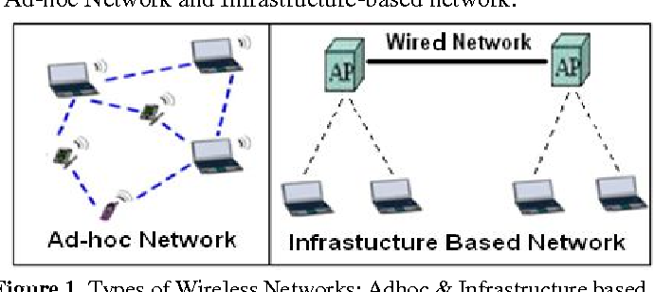
Types of Wireless Networks

Slide 32

Types of Wireless Communication
Bluetooth is a wireless technology that uses low-energy radio waves to send wireless data between Bluetooth-enabled devices. It's similar to Wi-Fi in that it operates over radio waves.

Slide 33
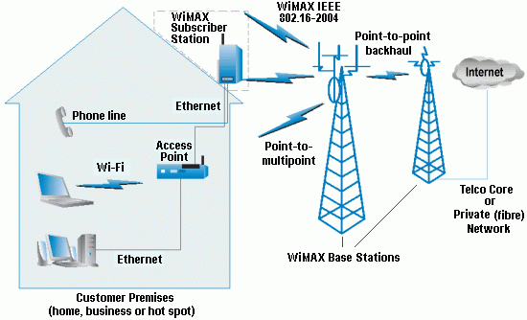
WiMAX
WiMAX stands for Worldwide Interoperability for Microwave Access
WiMAX refers to interoperable implementations of the IEEE 802.16 family of wireless-networks standards ratified by the WiMAX Forum.

Slide 34
Cellular Telephony
Cellular telephony is designed to provide communications between two moving units, called mobile stations (MSs), or between one mobile unit and one stationary unit, often called a land unit.

Slide 35
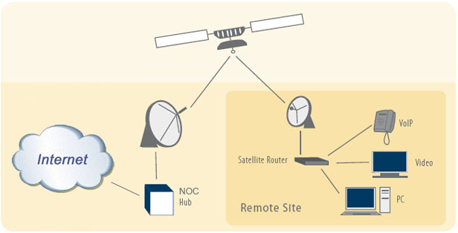
Satellite Networks
A satellite network is a combination of nodes, some of which are satellites, that provides communication from one point on the Earth to another.

Slide 36
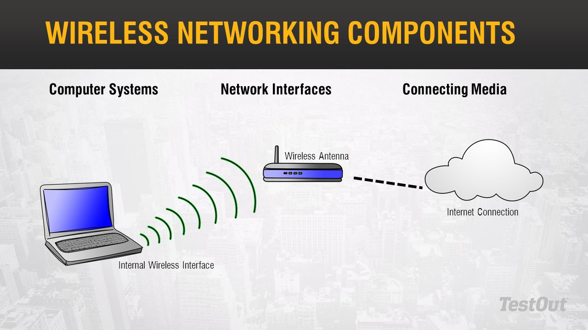
Wireless network Components
User Devices
Radio NICs
Access Points

Slide 37
Wireless LAN standards
IEEE 802.11
IEEE 802.11 is part of the IEEE 802 set of LAN protocols, and specifies the set of media access control (MAC) and physical layer (PHY) protocols for implementing wireless local area network (WLAN) Wi-Fi computer communication in various frequencies.
They are created and maintained by the Institute of Electrical and Electronics Engineers (IEEE) LAN/MAN Standards Committee (IEEE 802). The base version of the standard was released in 1997, and has had subsequent amendments.

Slide 38
Wireless LAN standards contd.
IEEE 802.11a
802.11a, published in 1999, uses the same data link layer protocol and frame format as the original standard, but an OFDM based air interface (physical layer).
It operates in the 5 GHz band with a maximum net data rate of 54 Mbit/s, plus error correction code, which yields realistic net achievable throughput in the mid-20 Mbit/s.
It has seen widespread worldwide implementation, particularly within the corporate workspace.

Slide 39
Wireless LAN standards contd.
IEEE 802.11b:
The 802.11b standard has a maximum raw data rate of 11 Mbit/s (Megabits per second), and uses the same media access method defined in the original standard.
802.11b products appeared on the market in early 2000, since 802.11b is a direct extension of the modulation technique defined in the original standard.
The dramatic increase in throughput of 802.11b (compared to the original standard) along with simultaneous substantial price reductions led to the rapid acceptance of 802.11b as the definitive wireless LAN technology.

Slide 40
Wireless LAN standards contd.
IEEE 802.11g
In June 2003, a third modulation standard was ratified: 802.11g. This works in the 2.4 GHz band (like 802.11b), but uses the same OFDM based transmission scheme as 802.11a.
It operates at a maximum physical layer bit rate of 54 Mbit/s exclusive of forward error correction codes, or about 22 Mbit/s average throughput.
802.11g hardware is fully backward compatible with 802.11b hardware, and therefore is encumbered with legacy issues that reduce throughput by ~21% when compared to 802.11a.

Slide 41
Wireless LAN modulation techniques
Modulation is what wireless networks use to send data. It enables the sending of encoded data using radio signals. Wireless networks use modulation as a carrier signal, which means that the modulated tones carry data. A modulated waveform consists of three parts:
Amplitude: The volume of the signal
Phase: The timing of the signal between peaks
Frequency: The pitch of the signal
Wireless networks use a few different modulation techniques, including the above mentioned : DSSS (direct-sequence spread spectrum), OFDM (Orthogonal Frequency Division Multiplexing)

Slide 42
Wireless LAN modulation techniques contd.
DSSS is the modulation technique that 802.11b devices use to send the data. In DSSS, the transmitted signal is spread across the entire frequency spectrum that is being used.
Orthogonal frequency division multiplexing (OFDM) is a modulation and multiplexing technique. Modulation is the process by which data is encoded onto a carrier signal, which is then amplified and applied to an antenna.

Slide 43
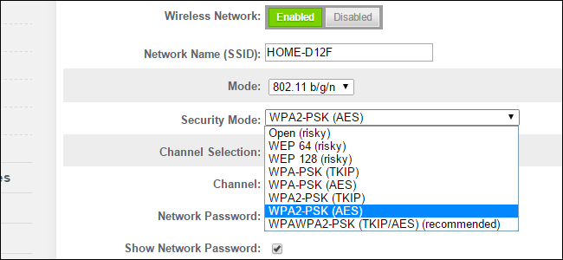
Wireless security Protocols
Wireless security is the prevention of unauthorized access or damage to computers or data using wireless networks, which include Wi-Fi networks. The most common type is Wi-Fi security, which includes
Wired Equivalent Privacy (WEP)
Wi-Fi Protected Access (WPA).
IEEE 802.1X

Slide 44
Wired Equivalent Privacy (WEP)
Wired Equivalent Privacy (WEP) is a security algorithm for IEEE 802.11 wireless networks.
WEP, recognizable by its key of 10 or 26 hexadecimal digits (40 or 104 bits), was at one time widely in use and was often the first security choice presented to users by router configuration tools.
Two methods of authentication can be used with WEP: Open System authentication and Shared Key authentication.

Slide 45
Wi-Fi Protected Access (WPA)
Wi-Fi Protected Access (WPA) is a security standard for users of computing devices equipped with wireless internet connections.
WPA was developed by the Wi-Fi Alliance to provide more sophisticated data encryption and better user authentication than Wired Equivalent Privacy (WEP), the original Wi-Fi security standard.
Wi-Fi Protected Access (WPA), Wi-Fi Protected Access II (WPA2), and Wi-Fi Protected Access 3 (WPA3) are three security and security certification programs developed by the Wi-Fi Alliance to secure wireless computer networks.

Slide 46
IEEE 802.1X
IEEE 802.1X is an IEEE Standard for port-based Network Access Control (PNAC). It is part of the IEEE 802.1 group of networking protocols.
It provides an authentication mechanism to devices wishing to attach to a LAN or WLAN.
The IEEE 802.1X standard defines a client and server-based access control and authentication protocol that restricts unauthorized clients from connecting to a LAN through publicly accessible ports.
802.1X authentication involves three parties: a supplicant, an authenticator, and an authentication server. The supplicant is a client device (such as a laptop) that wishes to attach to the LAN/WLAN. The term 'supplicant' is also used interchangeably to refer to the software running on the client that provides credentials to the authenticator.

Slide 47
Installing a wireless LAN
1. Find the best location for the wireless router. The optimal placement is in a central location of your home, free from obstructions that could cause wireless interference.
2. Turn off the modem. Power off the cable or DSL modem from your internet service provider before connecting your equipment
3. Connect the router to the modem. Plug an Ethernet cable (typically provided with the router) into the router WAN port. Then, connect the other end of the Ethernet cable to the modem
4. Connect a laptop or computer to the router. Plug one end of another Ethernet cable into the router LAN port (any port will work) and the other end of the Ethernet cable into the Ethernet port of a laptop.
5. Power up the modem, router, and computer. It's important that these devices be turned on in the proper order. Turn on the modem first. When the modem lights are all on, turn on the router. When the router is on, turn on the computer.
6. Go to the management web page for the router. Open a browser and enter the IP address of the router administration page. This information is provided in the router documentation (it's usually something like 192.168.1.1). The login information is also in the manual

Slide 48
Installing a wireless LAN contd.
. 7. Change the default administrator password (and username) for the router. This setting is usually found in the router administration page in a tab or section called Administration. Use a strong password that you won't forget.
8. Add WPA2 security. This step is essential. Find this setting in the wireless security section of the router administration page. Select which type of encryption to use and enter a passphrase of at least 8 characters. The more characters and the more complex the password, the better.
9. Change the wireless network name (SSID). To make it easy for you to identify your network, choose a descriptive name for your SSID (Service Set Identifier) in the wireless network information section of the router administration page.
10. Set up the wireless adapter on the computer. After saving the configuration settings on the router, unplug the cable that connects the computer to the router. Then, plug a USB or PC card wireless adapter into the laptop, if it doesn't have a wireless adapter installed or built-in.
11. Connect to the new wireless network. On your computer and other wireless-enabled devices, find the new network you set up and connect to the network.

Slide 49
Any questions ?
THANK YOU

